Slide 1

Shaun Lane Memorial Park
Town of Corning

Slide 2
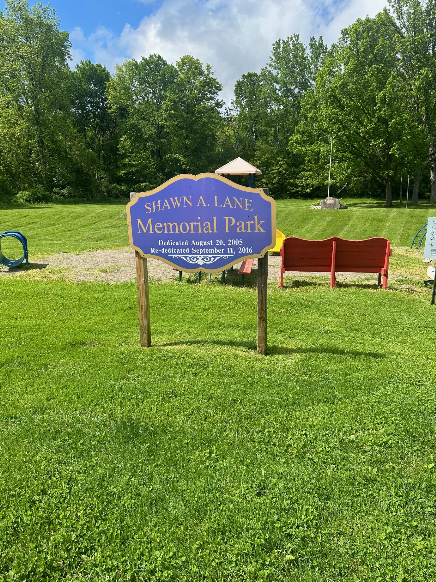
Response Overview
Total Surveys Mailed:
Total Responses: 23
Focus for the Playground
Small Children 4
Teens 2
Adults 3
Combination 16

Slide 3
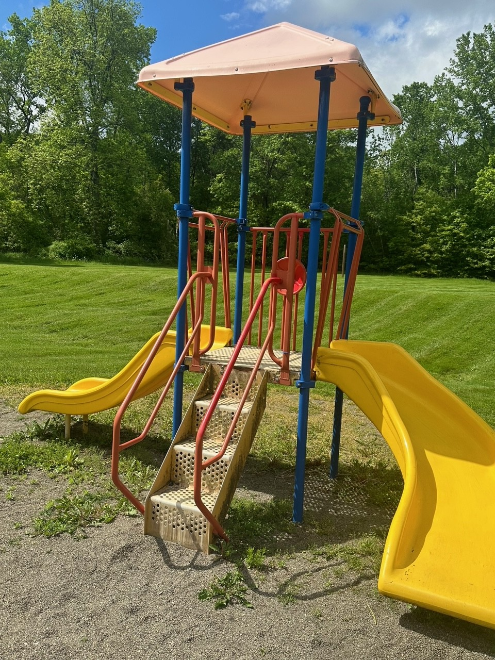
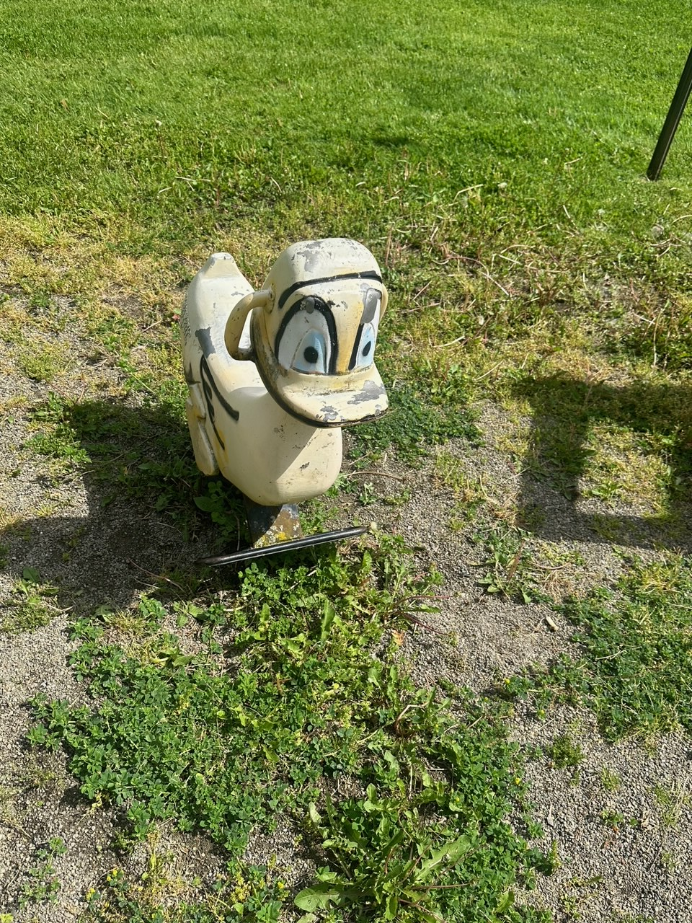
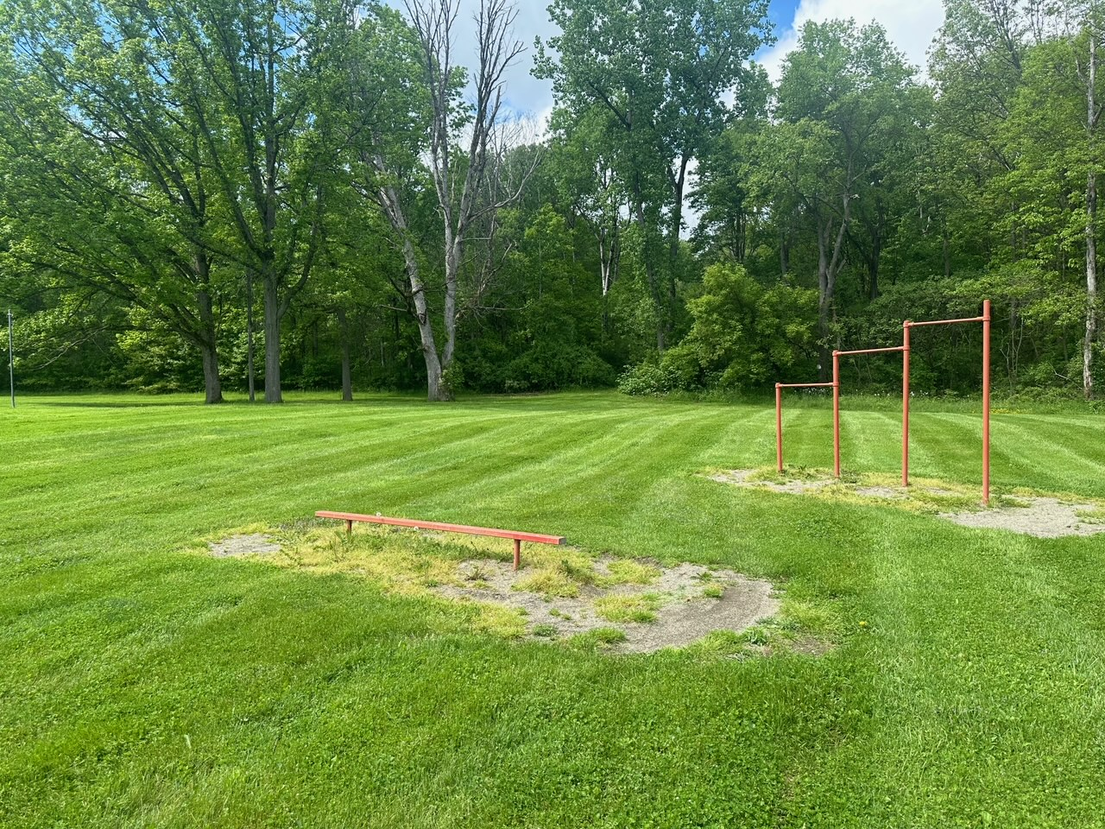
What Shaun Lane Park Currently Has…

Slide 4
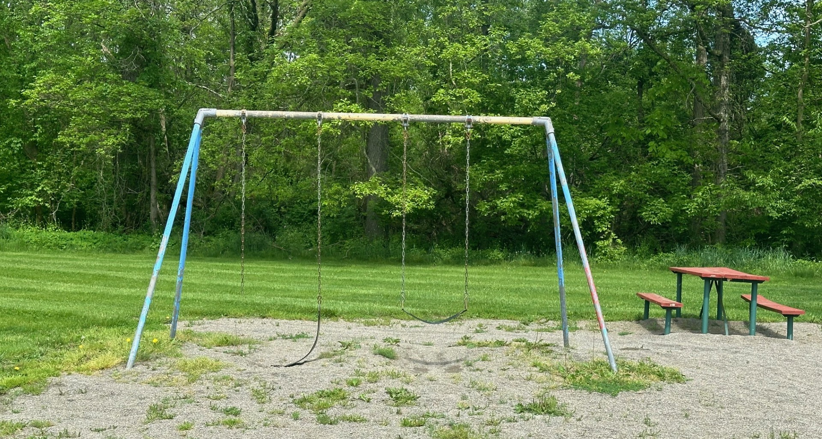
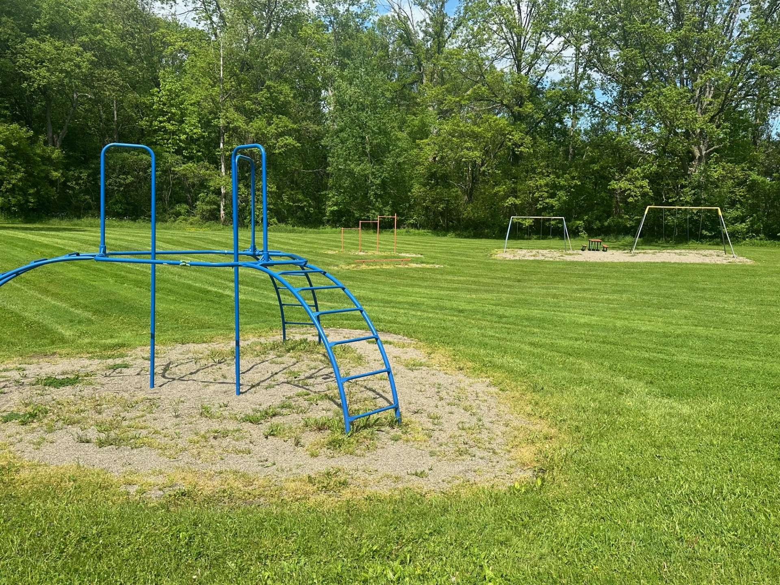
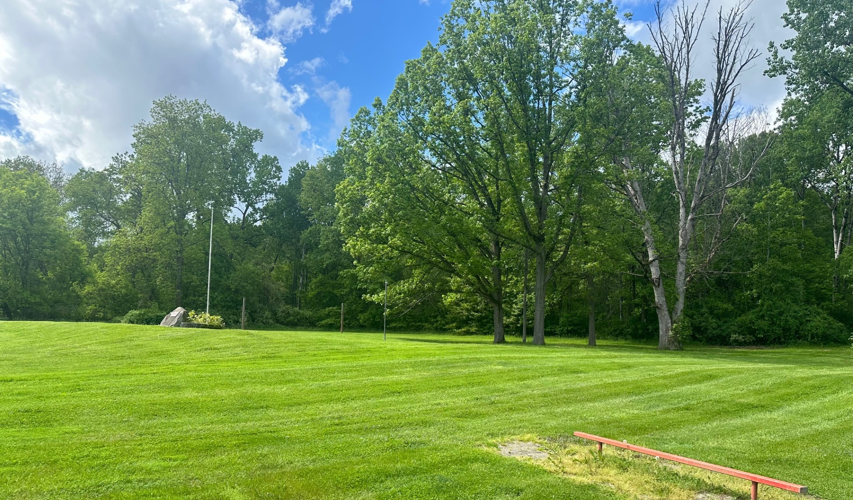

Slide 5
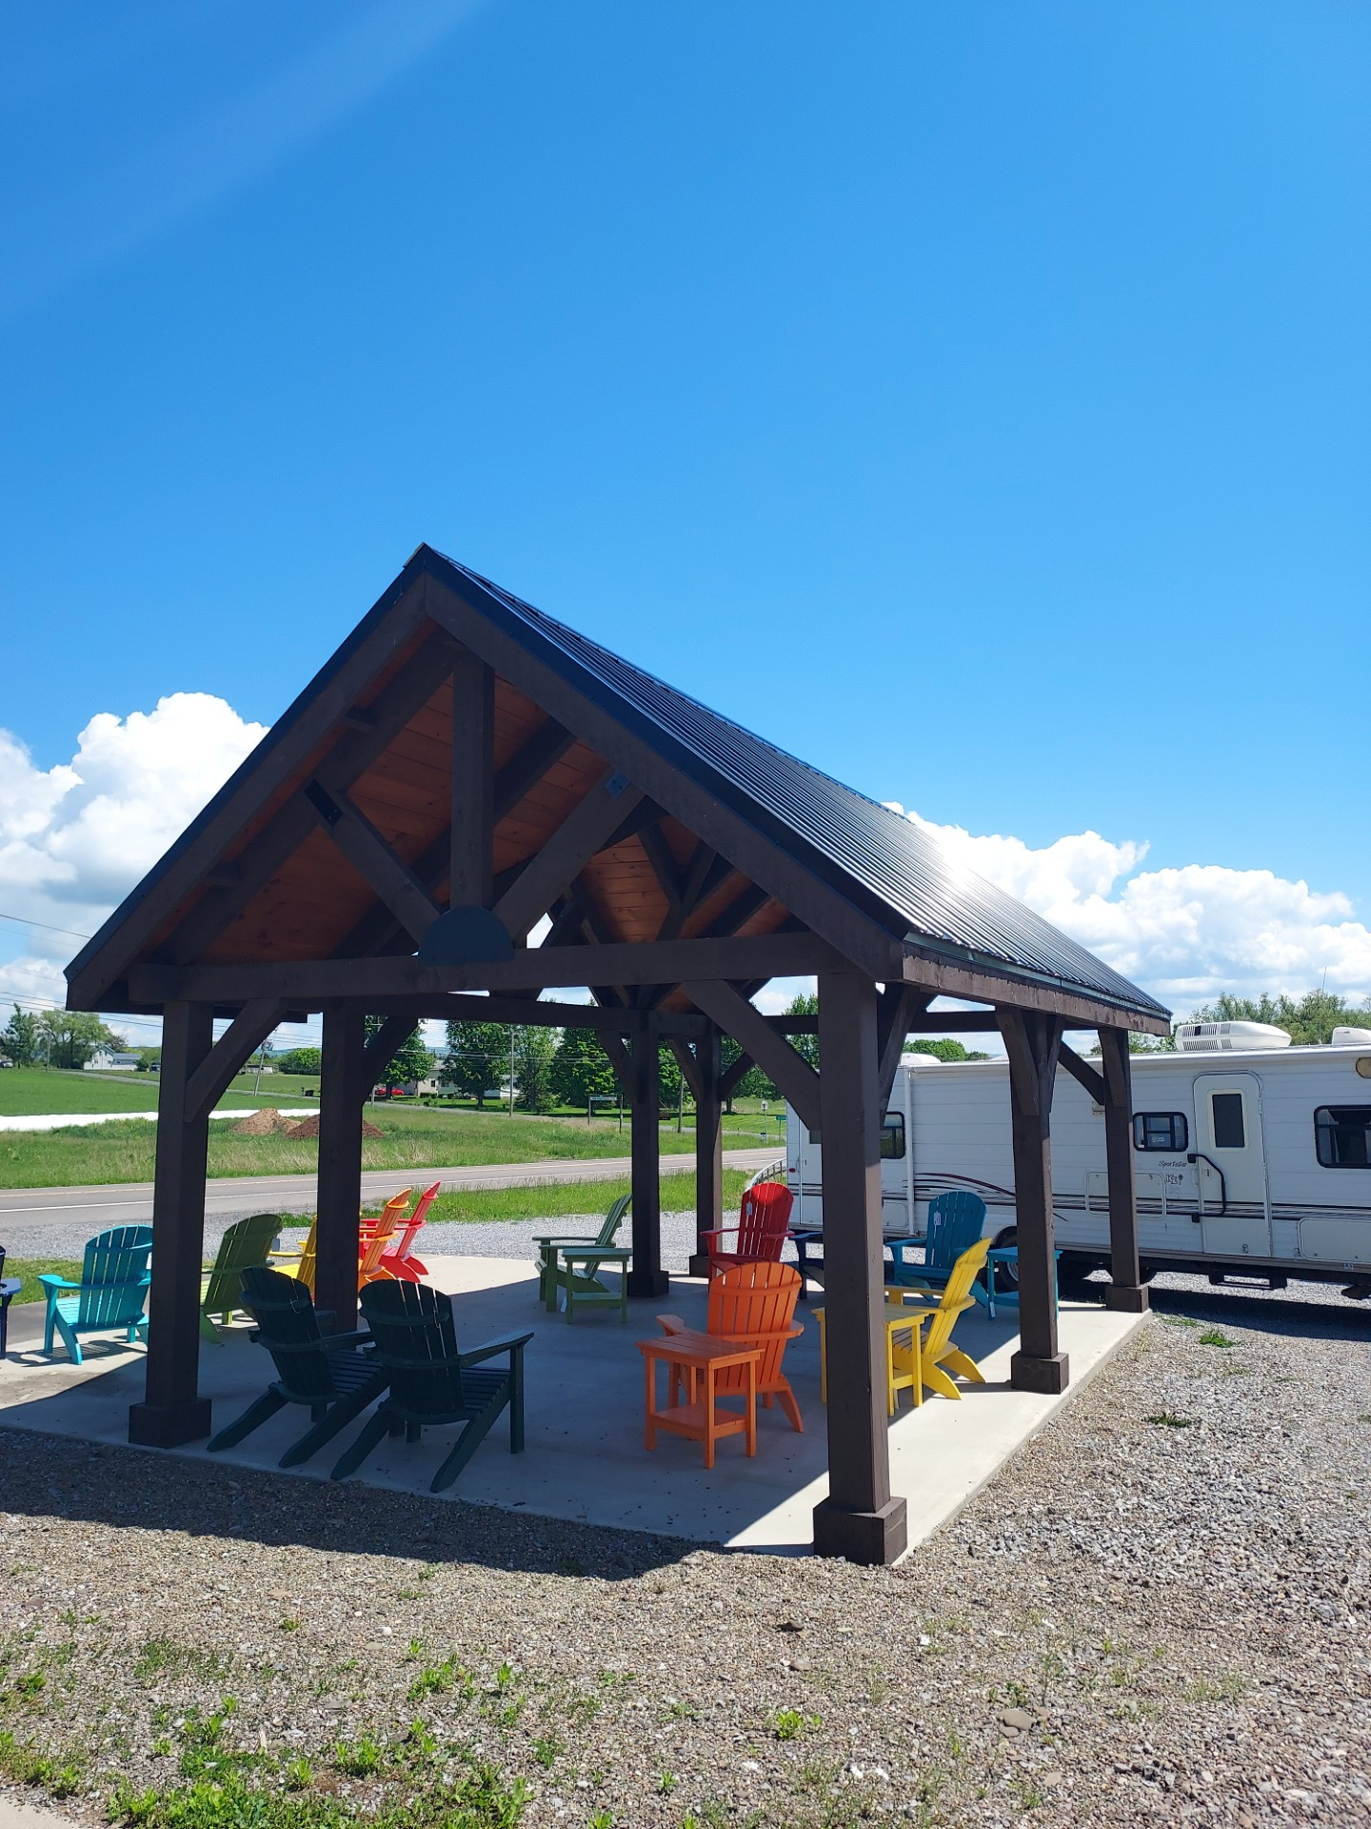
Pavilion
21 respondents wanted the pavilion
2 were opposed
Requested picnic tables, concrete pad, & charcoal grills. (22 yes and 1 no)
$5,000 pavilion (previously approved)
Grills: $1000 (for 2)
-Picnic tables: $1,500-2000 each x 2 ($3,000-4,000)
Total: Approx. $10,000

Slide 6
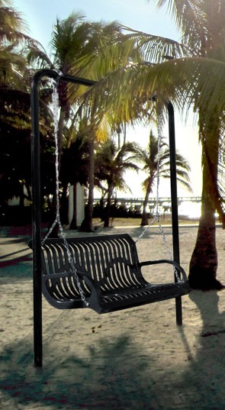
Bench Style Swing
Yes: 19
No: 4
Total Cost: $1,089 plus s/h

Slide 7
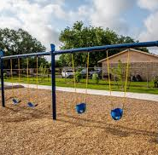
Swings
Swing set needs updating. Results for what residents would like to see:
Infant 16
Children 18
Tire Swing 11
None of the Above 2

Slide 8
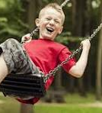
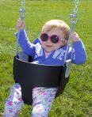
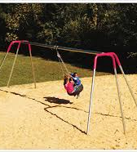
Swing Set Options
Infant Swing $86 each plus chains and s/h
Children Swings $200 plus s/h
Tire Swing $2,354 plus s/h
Bipod Swing set with Swings and Chain $1,200
Total not to exceed: $5,000

Slide 9
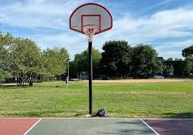
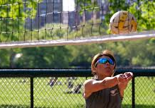
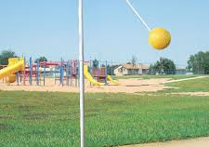
Additions to the Park
Basketball Court 15
Volleyball Net (Currently have posts but net was damaged) 7
Tetherball (Currently have post but ball was damaged) 3
None of the Above: 5

Slide 10
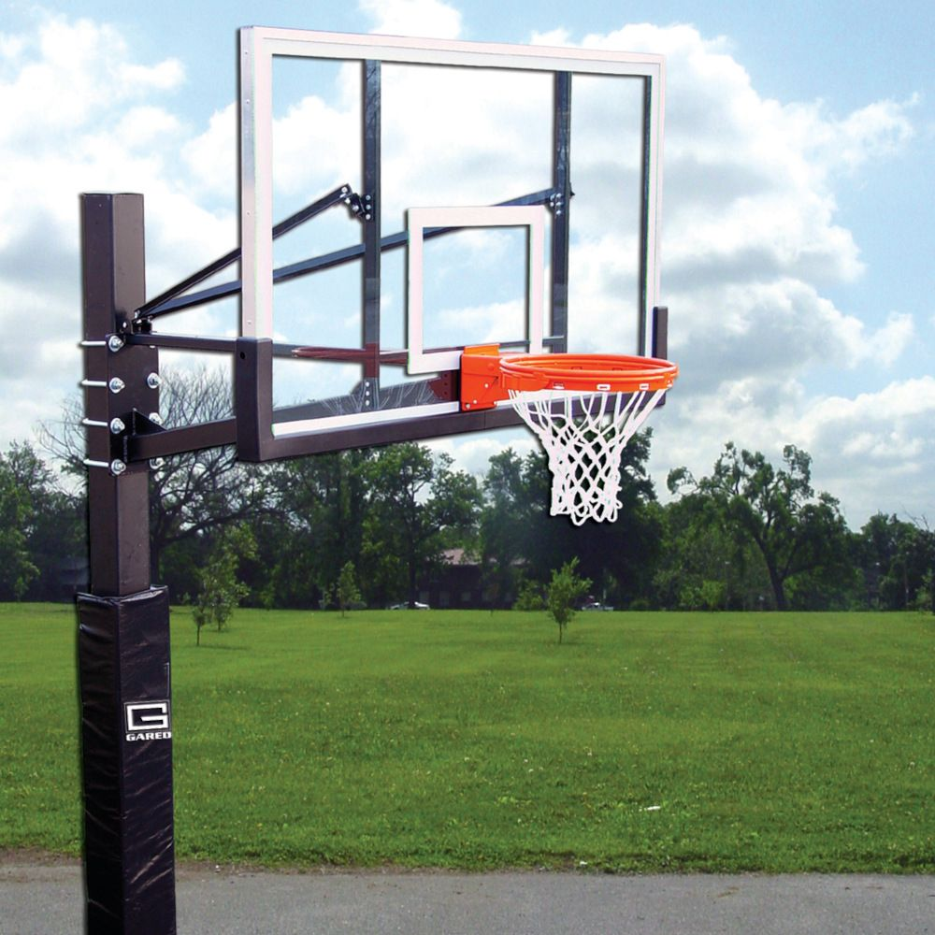
Basketball Court
Steel Playground System $3,100
Additional materials for placing court: $1,000 or less

Slide 11
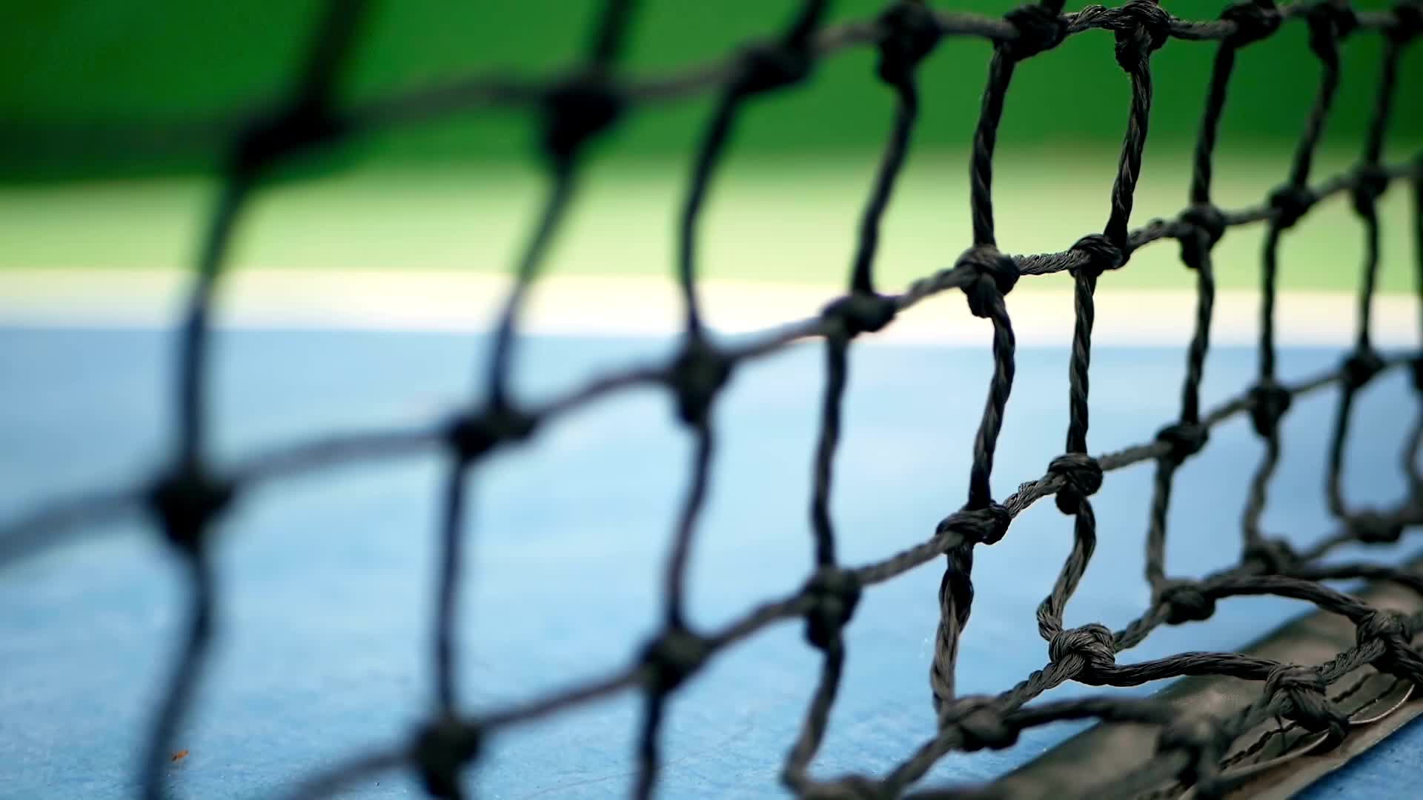
Volleyball Net and Tetherball
Volleyball Net Replacement: $200 or less
Tetherball: $25-50

Slide 12
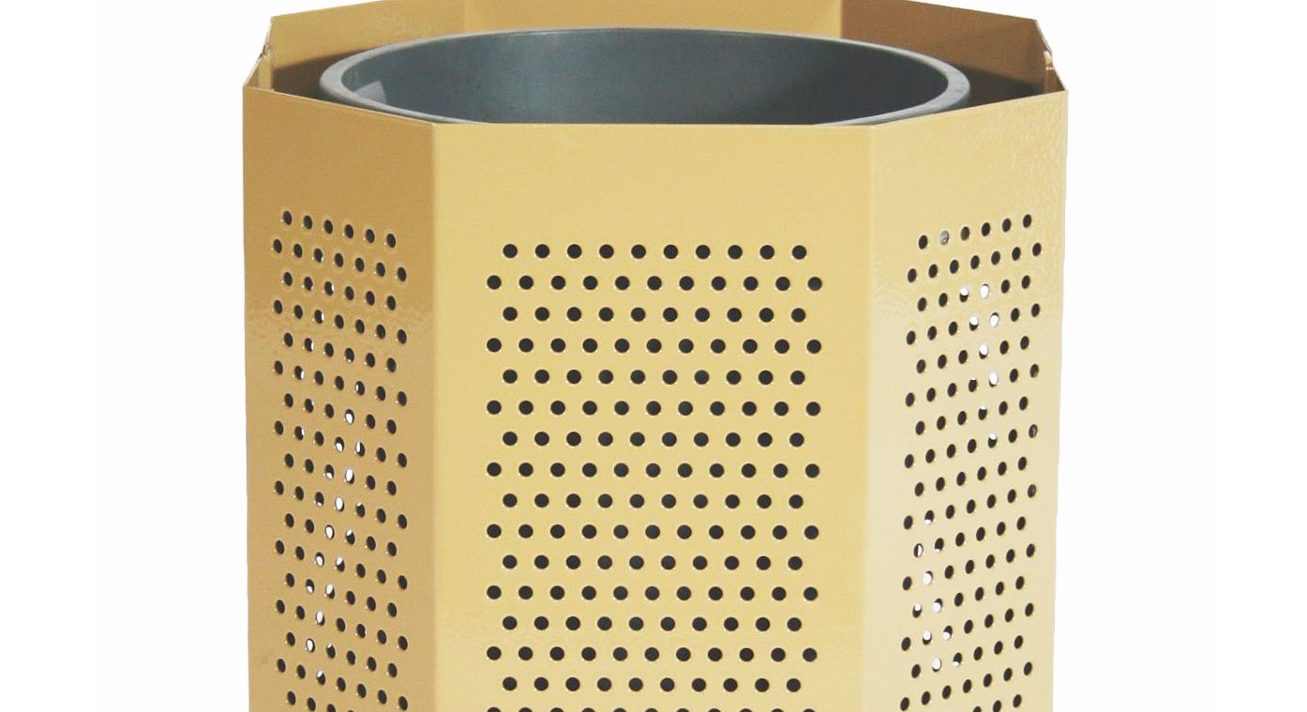
Additional Equipment…
Trash Cans: $150 each x 4 ($600)
Trash Can lid

Slide 13
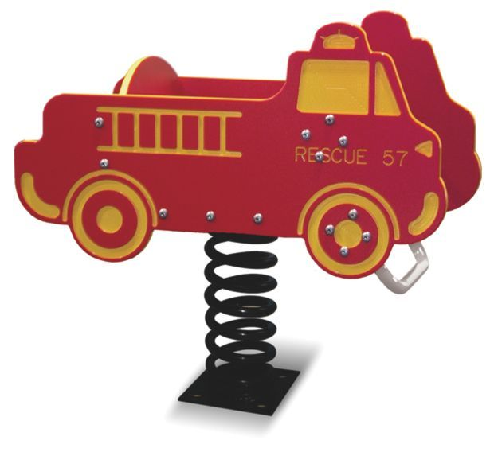
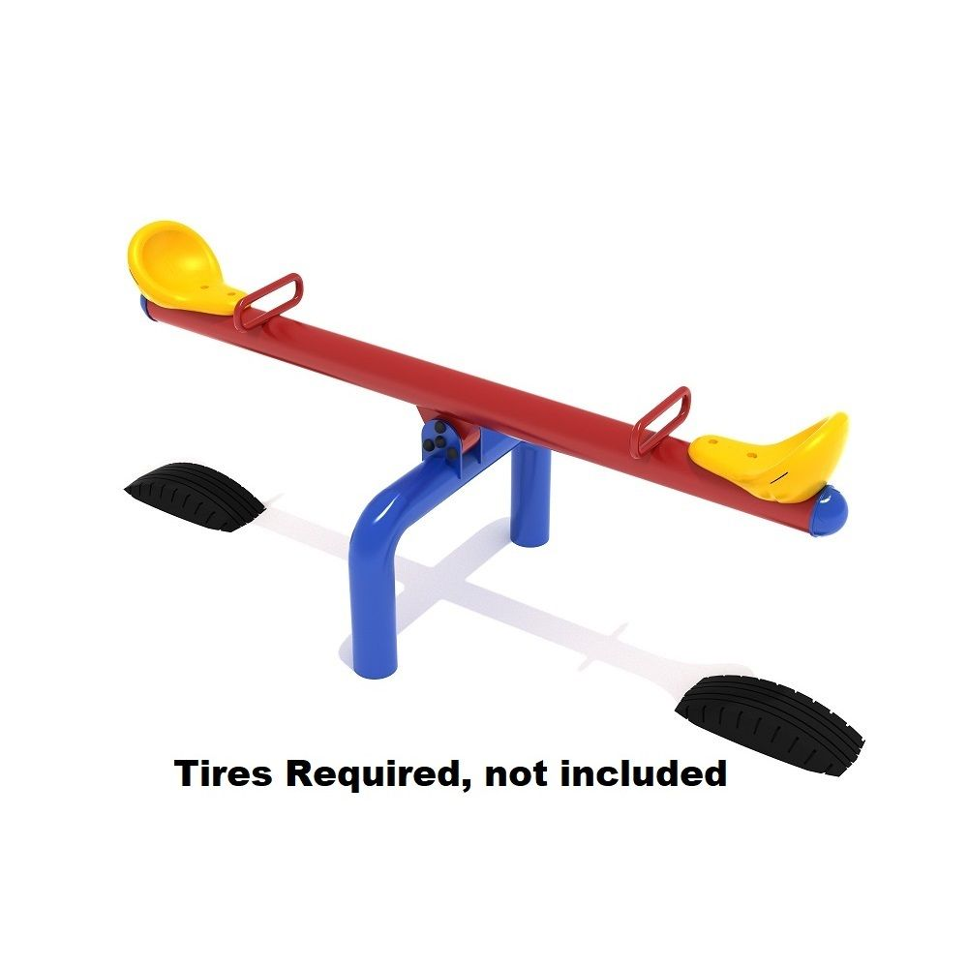
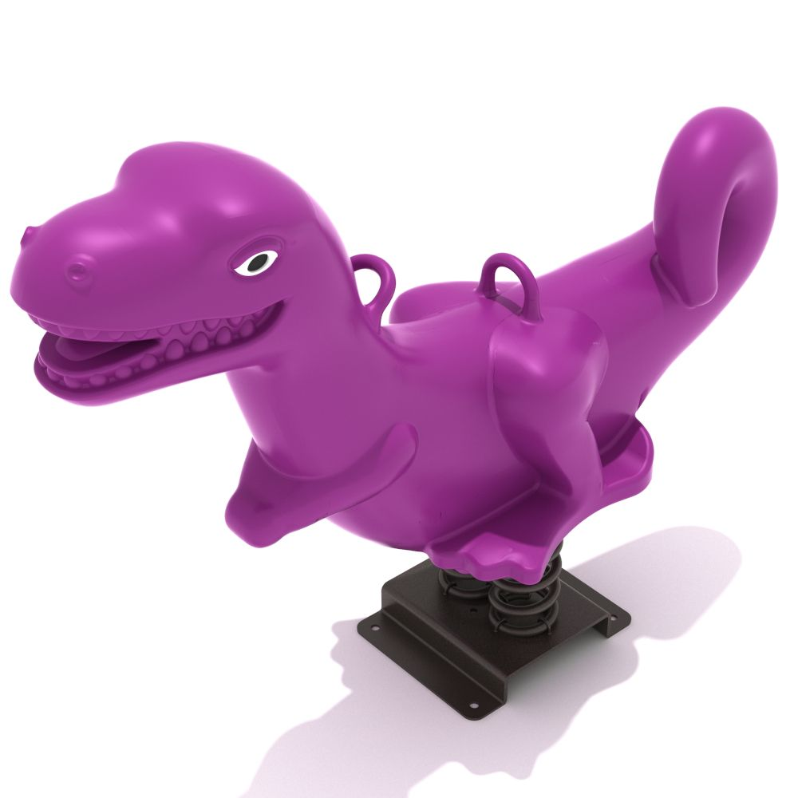
Replacements & Additions
Fun Bouncers $1,000 each
Charlie Chomper Fun Bounce
Fire Truck Single Seat Spring Rider
Classic Seesaw $1,200 each

Slide 14
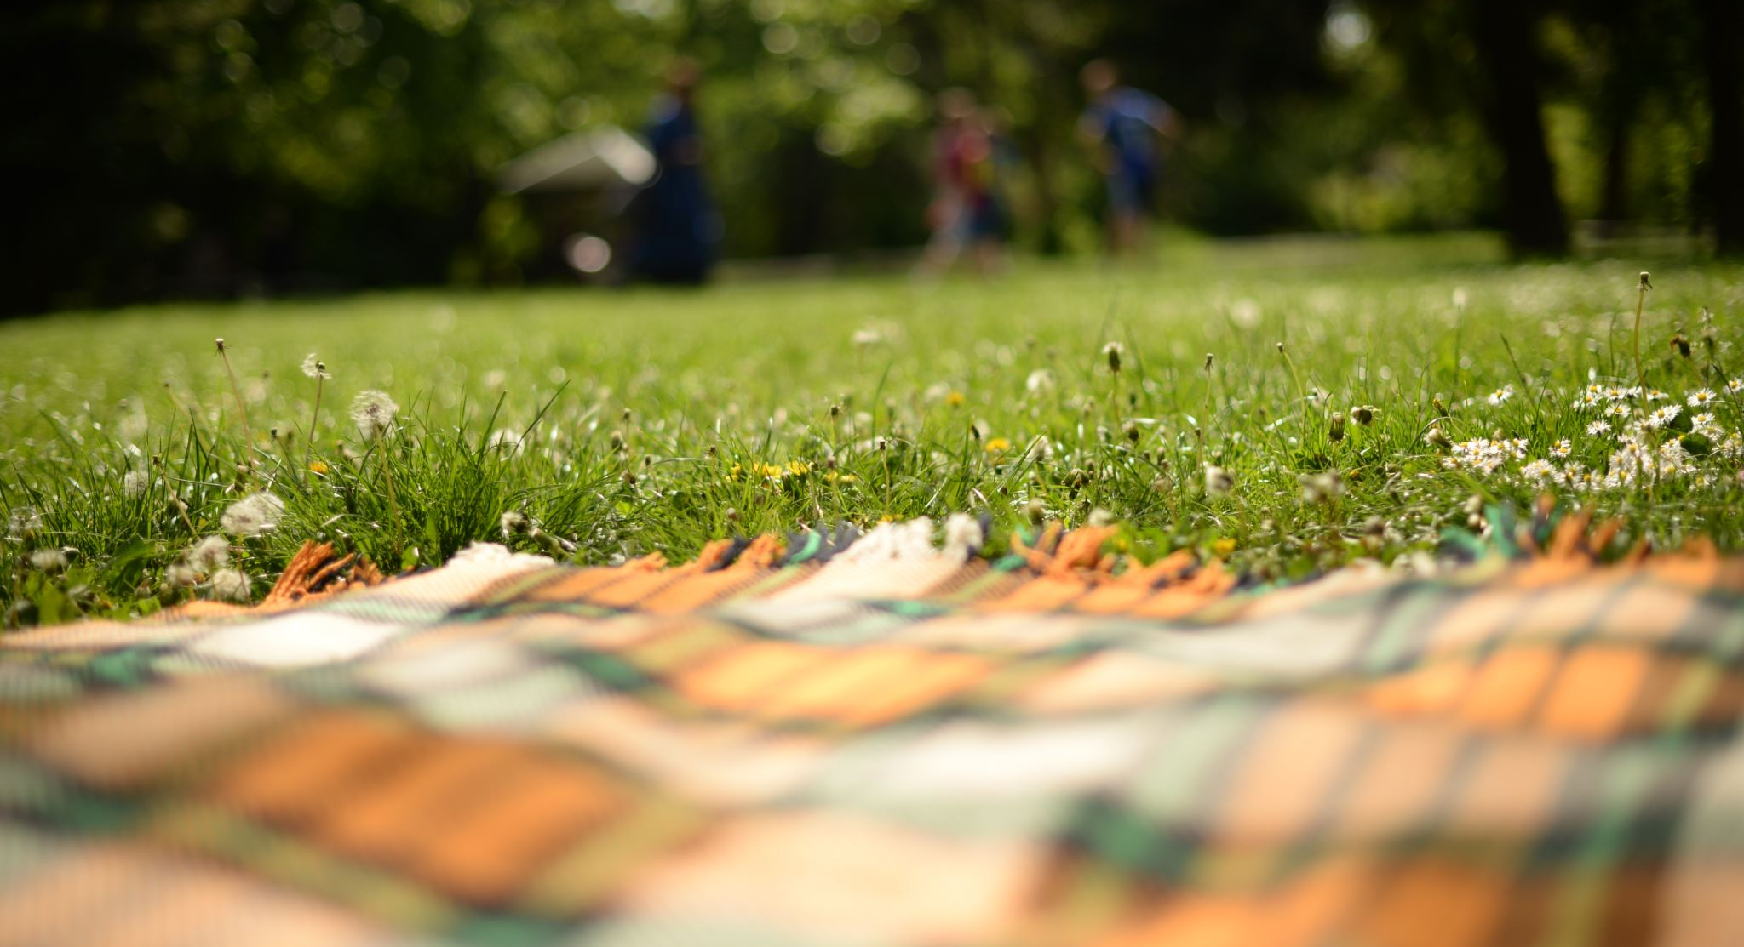
What Residents Want…
A place to have picnics, grill and relax.
The parks program to come back!
A place for children to play.
Bike riding
A nice place for children and adults

Slide 15
Cost of Playground Updates
ITEM | COST
Pavilion with grills & tables | $10,000
Swing sets to include: Tire swing (1), replacement children swings (2), infant swings (1), bench swings (2) & additional swing set | $6,000
Basketball Court | $5,000
Volleyball and Tetherball | $300
Trash Cans | $600
Spring Riders, & Seesaw | $3,500
Total | $25,000 (approximate)

Slide 16


