Slide 1

Town of Corning
2025 Housing Needs Assessment
Dot Richter, MPA, Grants Administrator
Southern Tier Central Regional Planning and Development Board (STC)
Presentation for Town Of Corning, NY
12/16/2025

Slide 2

Introduction
Dot Richter
Grants Administrator

Slide 3

Tonight's Purpose?
Town is required to have a 2nd public hearing prior to the closeout of its Community Development Block Grant (CDBG), sharing the results of the housing needs assessment.
Review:
Initial Data
Survey Process
Survey Results
Goals & Future Actions

Slide 4
Town of Corning Community Snapshot (Census Data)
59.6 % of the Population is employed
14.1% of the population is living with a disability
6.2% Veterans
6.6% of the population living at or below poverty (11.5% are under 18 yrs.)
19.1% of population is over 65 years old

Slide 5
Town of Corning Housing Snapshot
(Census Data)
59% owner-occupied housing units
92% of housing units appear to be occupied
20.5% of the housing units were built in 1939 or earlier
Median home value of owner-occupied units is $175,500
17.2% of households spend 30% or more on housing costs

Slide 6
Housing Needs Assessment: Public Input and Data Gathering
Community survey (housing & public sewer) was mailed to all residents in April 2025, requesting responses by June 2, 2025. An online option was provided in the mailed survey and on the Town website (Town continued to accept responses through July 24th).
Windshield survey of residential structures in Town was conducted in May 2025.

Slide 7

Community Survey Response Rate
Survey delivered to approximately 2270 addresses and the response rate was:
20%

Slide 8

Housing Needs & Public Sewer Survey Responses
(Community Survey)
Which condition best describes the house that you live in?
  9.53% Many repairs needed - roof leaks, poor or no foundation, dangerous wiring, needs siding, etc.
  45.12% No repairs needed - to the roof, foundation, wiring, plumbing, etc.
  45.35% Some repairs needed - has old roof, poor wiring, no insulation, etc.

Slide 9
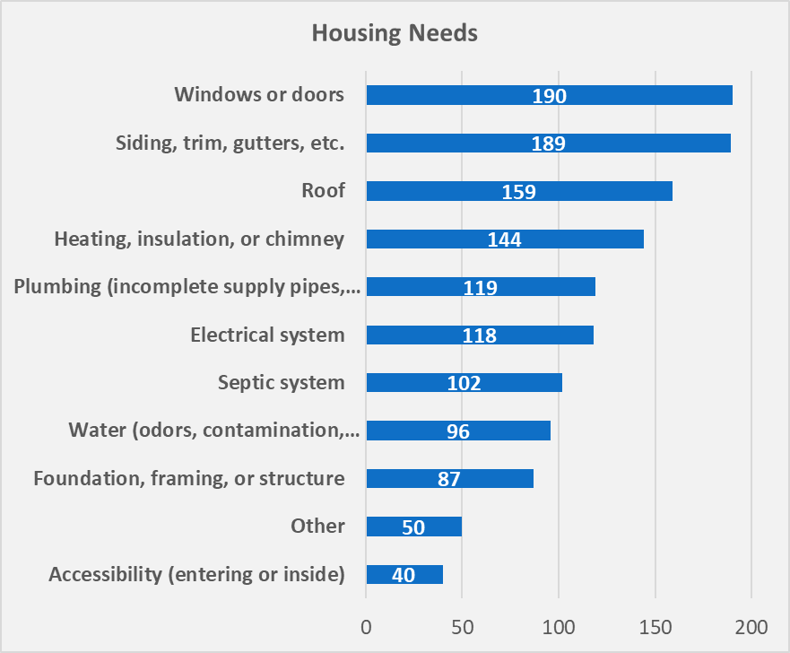
Additional responses
Approximately:
26% of respondents indicated the plumbing in their home is an issue (incomplete supply pipes, toilet, bathtub, shower, etc.)
26% of respondents indicated the electrical system in their home is an issue
22% of respondents indicated the septic system of their home is an issue
21% of respondents indicated water issues (odors, contamination, insufficient supply, etc.) in their home
19% of respondents indicated the foundation, framing, or structure of their home is an issue
9% of respondents indicated accessibility (entering or inside) to their home is an issue

Slide 10

Windshield Survey
Throughout May 2025, STC staff & Town of Corning Housing Steering Committee members surveyed exterior conditions of 2,314 housing units.

Slide 11

Windshield Survey Scoring Scale
Excellent (5) – no apparent problems
Good (4) – not as good condition as those homes rated “Excellent (5)” but no to little repairs appear to be needed
Average (3) – minor repairs appear to be needed
Poor (2) – major repairs appear to be needed
Deteriorated (1) – structure potentially needs to be completely rebuilt

Slide 12
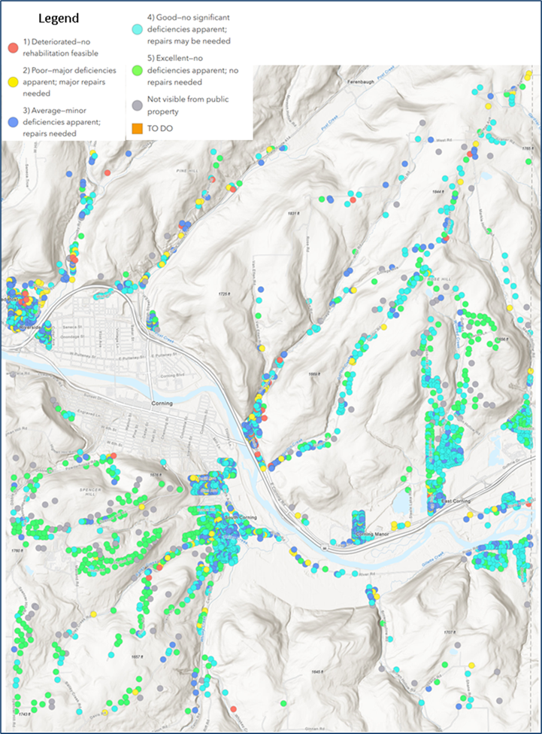
Windshield Survey Scoring Results
Rating | Percentage and Count
5 (Excellent) | 20.6% (476 houses)
4 (Good) | 43.1% (998 houses)
3 (Average) | 26.1% (604 houses)
2 (Poor) | 8.7% (201 houses)
1 (Deteriorated) | 1.5% (35 houses)

Slide 13
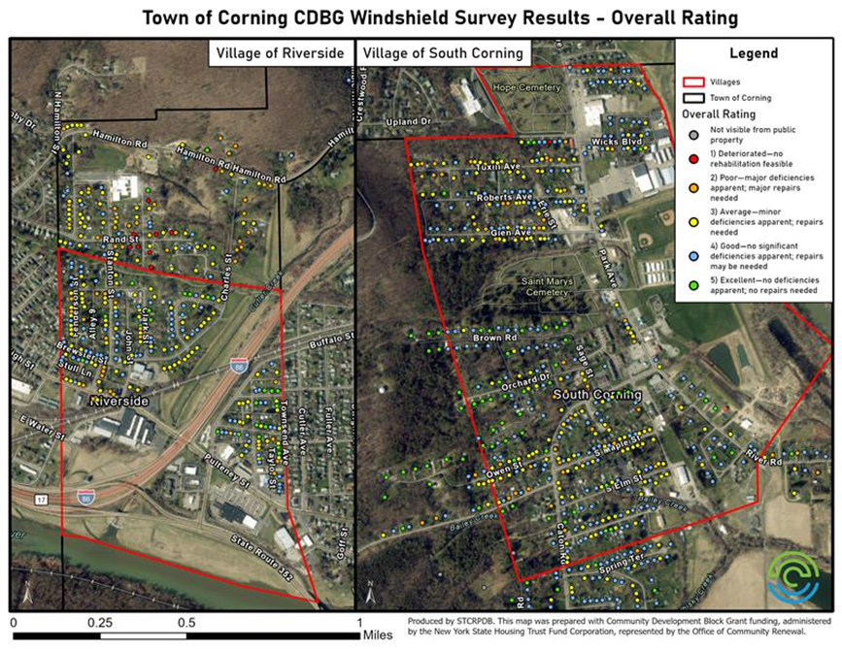
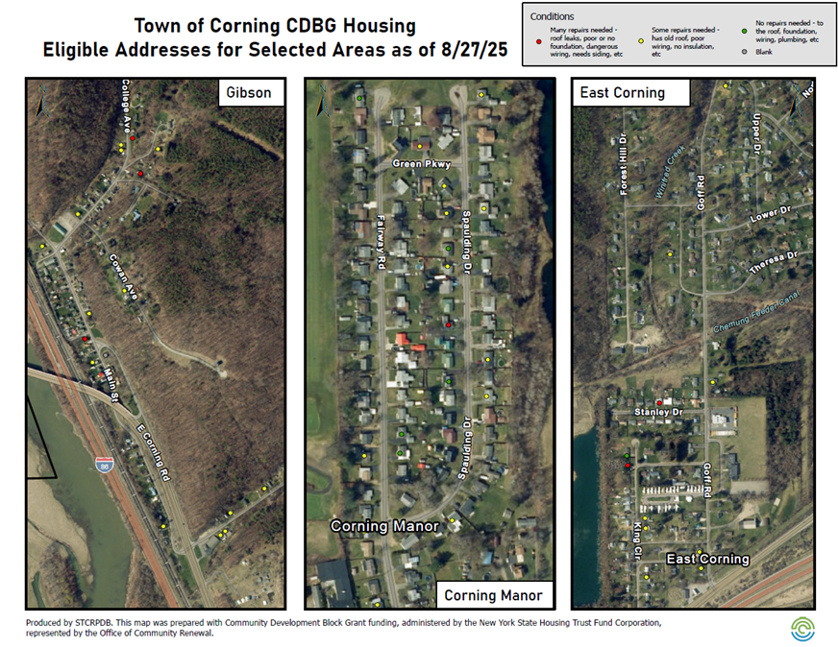
Deeper dive…

Slide 14
Limitations of the Windshield Survey
Survey is subjective based on the opinions of the surveyors
All areas of the house may not be visible from the road
There may be issues on the interior of the house that cannot be identified from the windshield survey (i.e. water damage, heating and insulation issues, etc.)

Slide 15

Town of Corning’s
Housing Goals

Slide 16

The housing needs assessment has identified issues and potential areas to improve in the future, per the following housing goals:
Offer a program for owner-occupied, single-unit, residential properties to apply to the Town for rehabilitation assistance. (CDBG for Housing Activities September 2025)
Provide information to residents about existing housing assistance programs, such as:
    ProAction of Steuben and Yates (Energy Savings & Weatherization)
    Arbor Housing & Development
    Bishop Sheen Ecumenical Housing Foundation
Become a designated New York State Pro-Housing Community
Review local regulations relating to housing and property maintenance to determine whether the rights and responsibilities of residents are adequately addressed.

Slide 17
Address Housing Goal 1:
CDBG Housing Activities Grant
Application submitted, September 2025
    Applied for $400,000
    143 interested respondents from the community survey that appear to be income-eligible
    132 of these income-eligible respondents live in stick-built or modular homes, 11 live in mobile homes
Note: Should application be unsuccessful, Town of Corning will consult with Office of Homes and Community Renewal and resubmit in September 2026

Slide 18

Further Considerations
With 143 potential eligible and interested owner-occupied, single-family homes, the Steering Committee determined:
  Primary focus would be on securing structures: roofs first, followed by foundations, potable water, and septic. Any code violations would also be addressed.
  Additionally, given the volume of interest, it was determined to focus on Town only for 2026 Housing Activities.
      Documentation will be provided to both Villages (South Corning & Riverside) to develop 2026 CDBG Housing Activities Applications.
      This would allow greater funds to be secured to address housing issues quicker – addressing housing needs on 3 fronts. It would also allow for village owner-occupied homeowners to move up the list quicker.
This Photo by Unknown Author is licensed under CC BY

Slide 19

Address Remaining Housing Goals
Pro-Housing Community: is in process, with assistance from Steuben County IDA.
Provide information to residents about existing housing assistance programs
Review local regulations relating to housing and property maintenance

Slide 20

Questions?
Contacts:
Town Supervisor, Jenniffer Tuttle
  Email: supervisor@townofcorningny.org
  Phone: (607) 936 6114 ext. 5
STC Grants Administrator, Dot Richter
  Email: drichter@stcplanning.org
  Phone: (607) 962 5092 ext. 209

